Slide 1
Staying Safe
What to do if you find a knife
A Presentation by Woolwich Riverside Ward NHW

Slide 2
Knifes are Dangerous
In our area there are many people who carry knives
Some people carry knives and hide them where their friends can find them easily
People can get hurt because of knives
Knives are used to frighten people and sometimes hurt them
They are left in bushes, behind walls, in between sheds etc

Slide 3
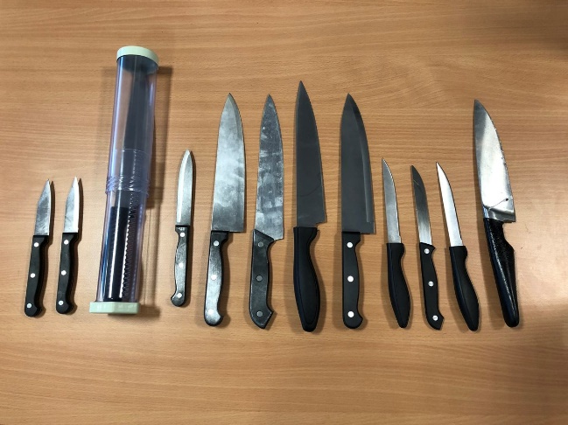
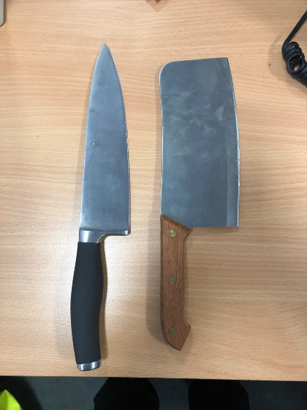
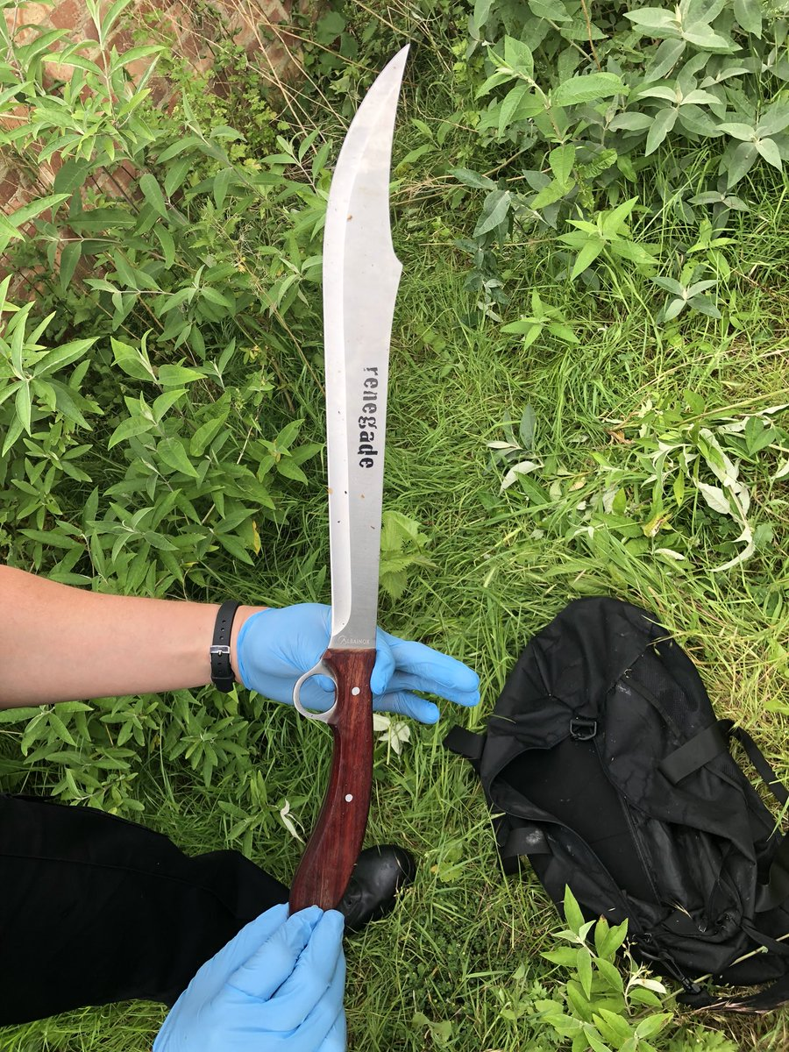
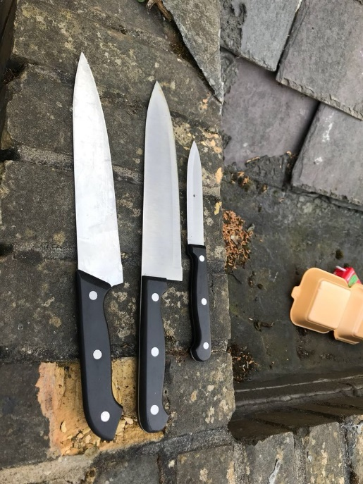
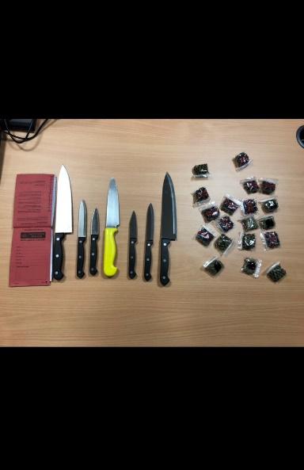
These are knives found in OUR area by the local police teams

Slide 4
What Should You Do If You Find A Knife?
Should You Pick It Up?
No - Its very dangerous, it has a sharp blade and you could hurt yourself
Should you just leave it and say nothing?
No – You should report it to an adult and the police call 101 OR 999
Can you describe it?
Saying what it looks like gives the police great information
You need to tell police where it is
Giving the police the correct location of the knife is really, really useful
ABOVE ALL STAY SAFE

Slide 5
What You Should Do If You Find a Knife?
Step 1 DO NOT PICK IT UP
Step 2 GET AN ADULT TO CALL THE POLICE - 999
Step 3 GIVE A DECRIPTION OF THE KNIFE
Step 4 LOCATION OF THE KNIFE
Step 5 WELL DONE YOU HAVE MADE YOUR AREA SAFER

Slide 6
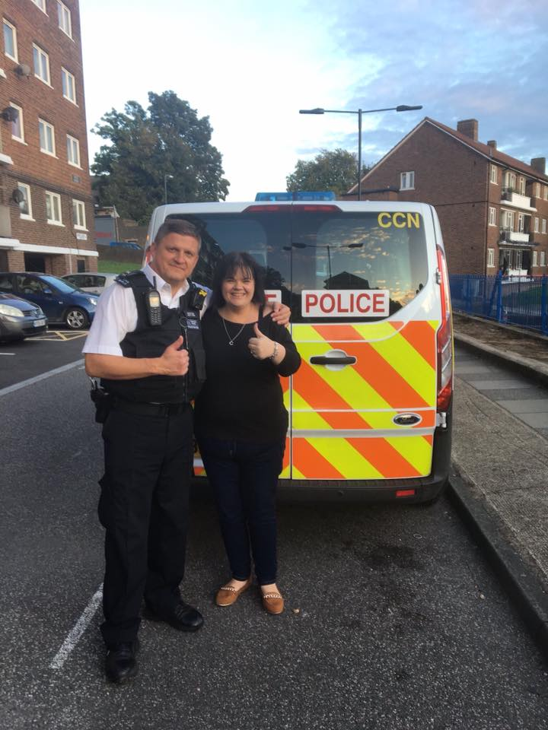
WORKING TOGETHER WE CAN BUILD A SAFER STRONGER COMMUNITY
Joining Neighbourhood Watch
Helping with Weapon Sweeps
Assisting the police teams who work to keep our area safe.

